Slide 1
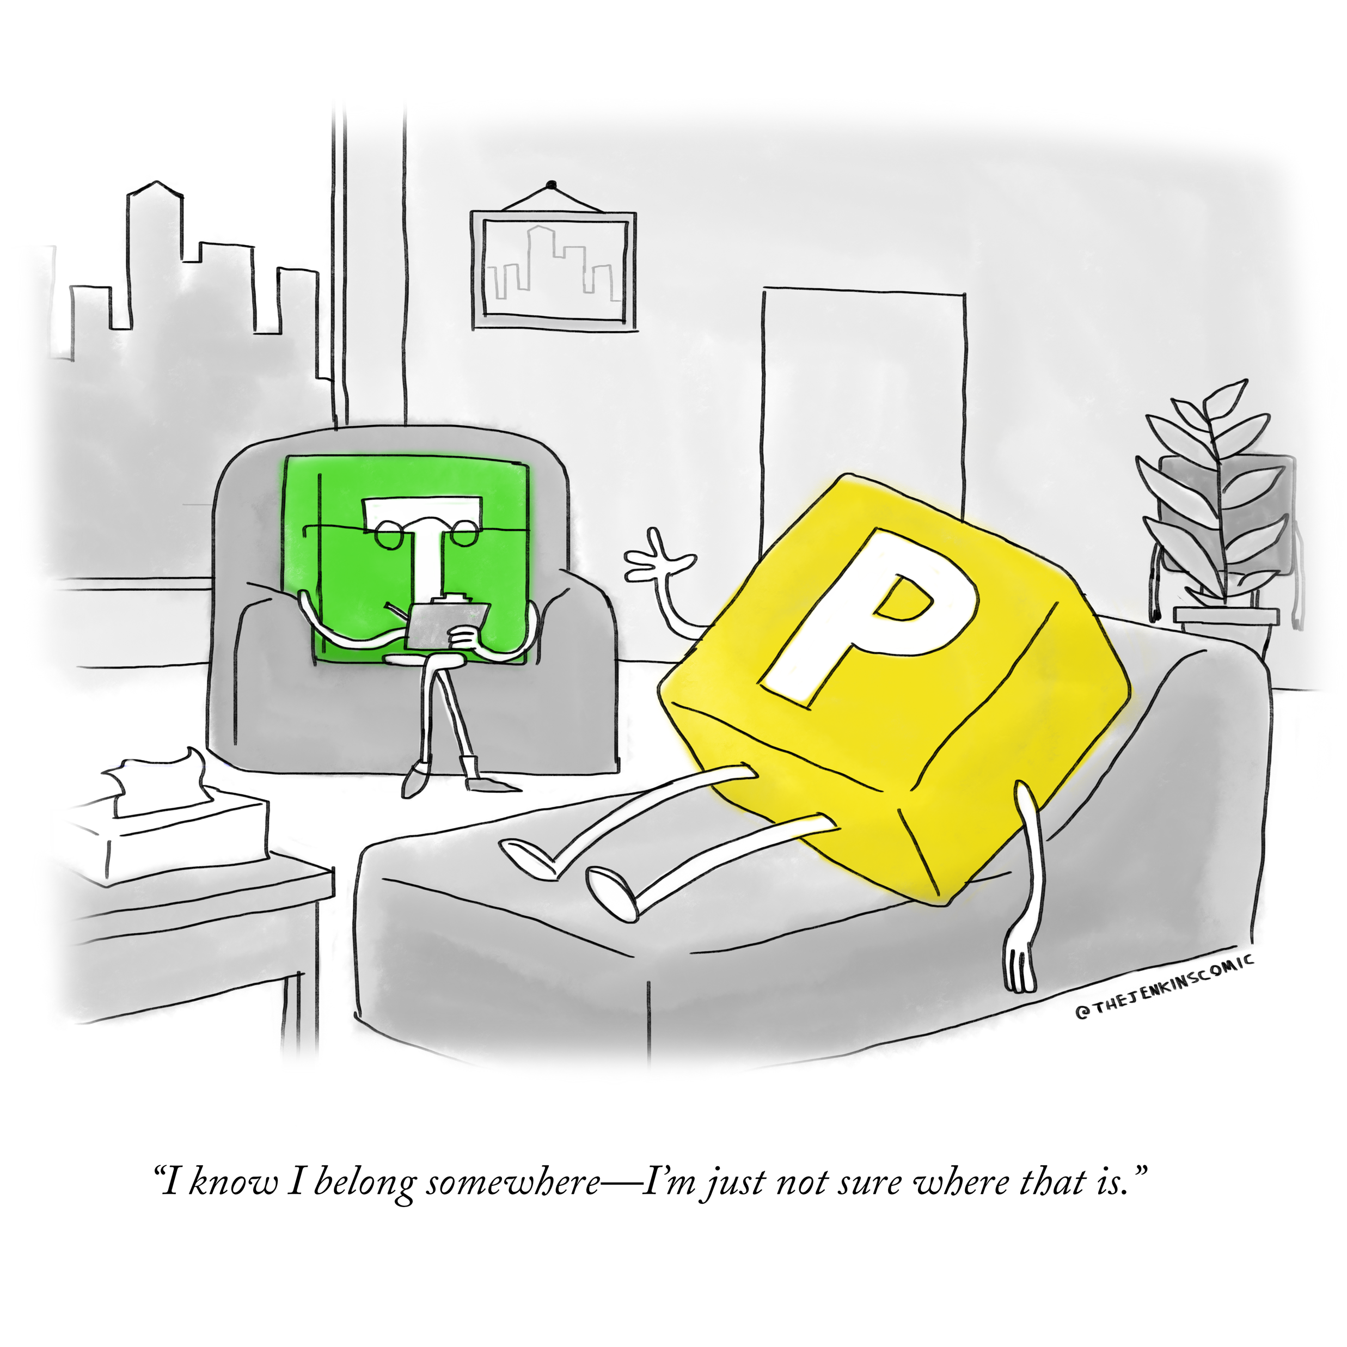
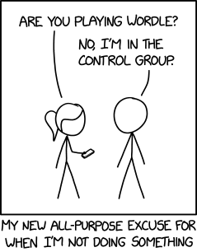
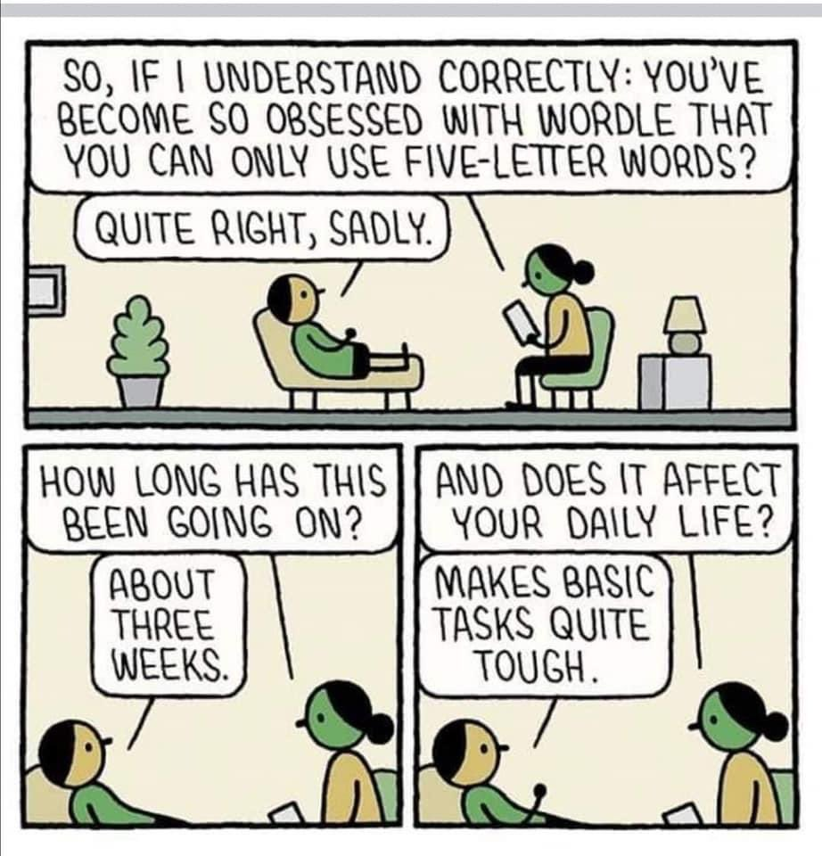
Wordle!
Week 8 | Lecture 3 (8.3)

Slide 2
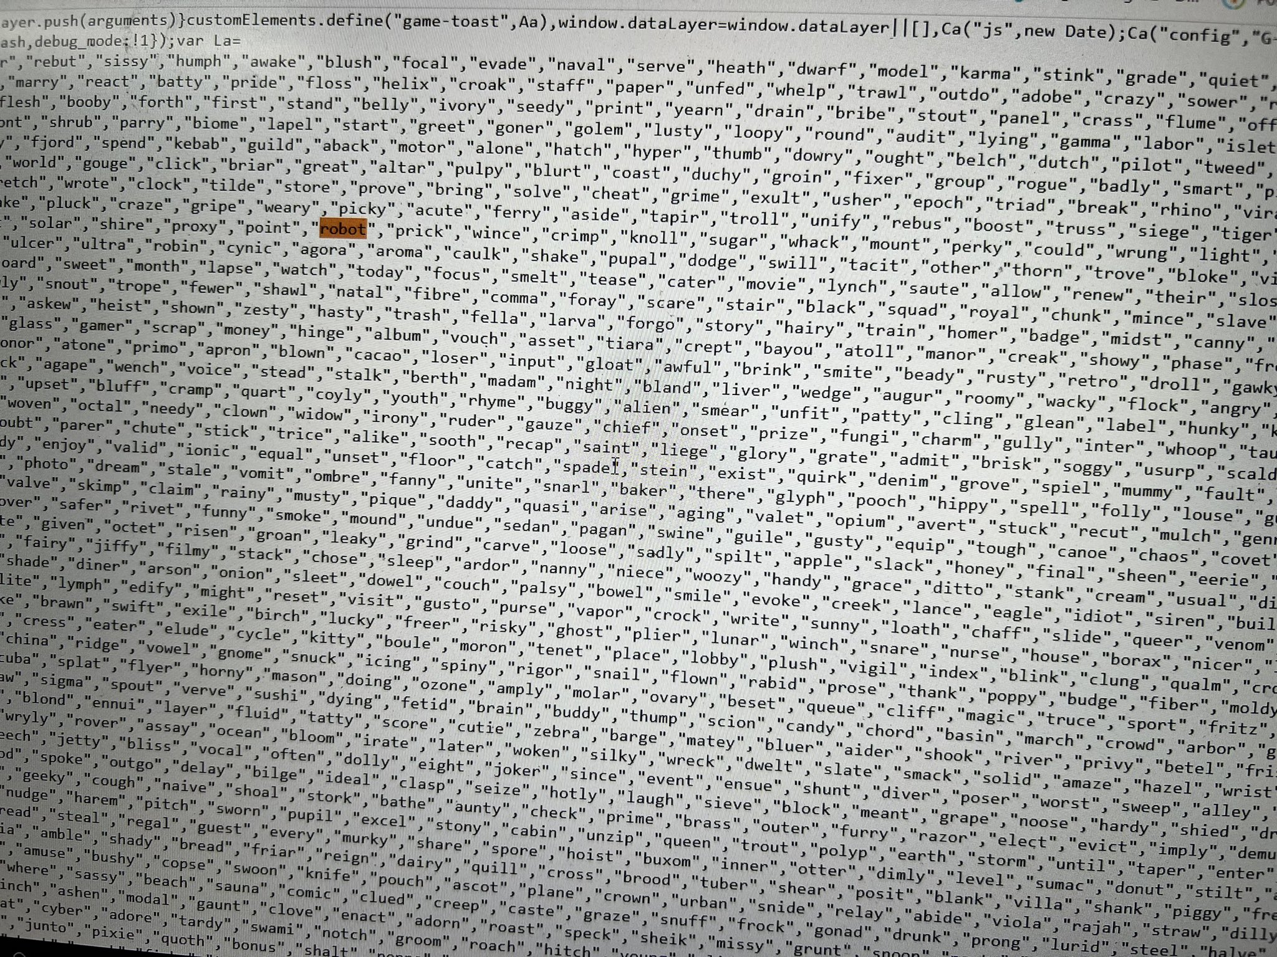
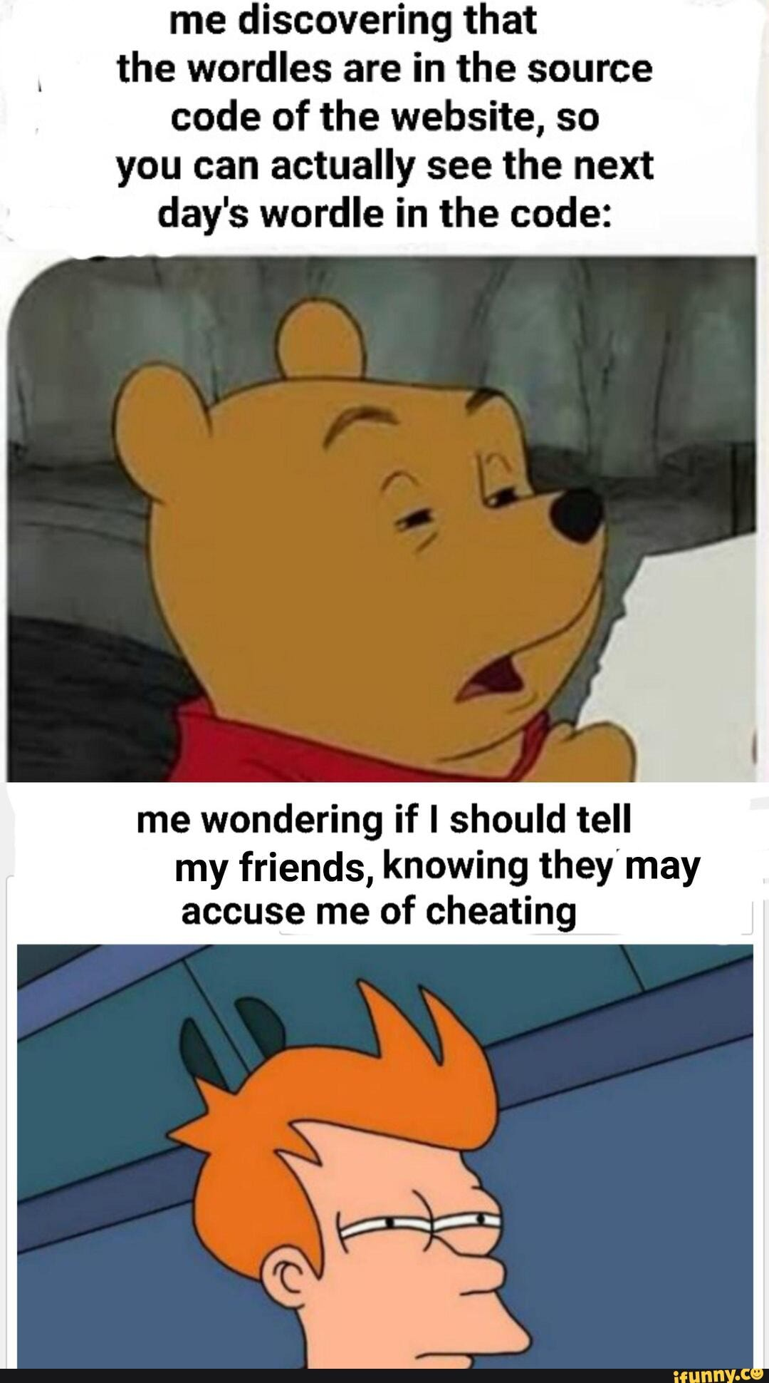
How did Josh Wardle store solutions?

Slide 3
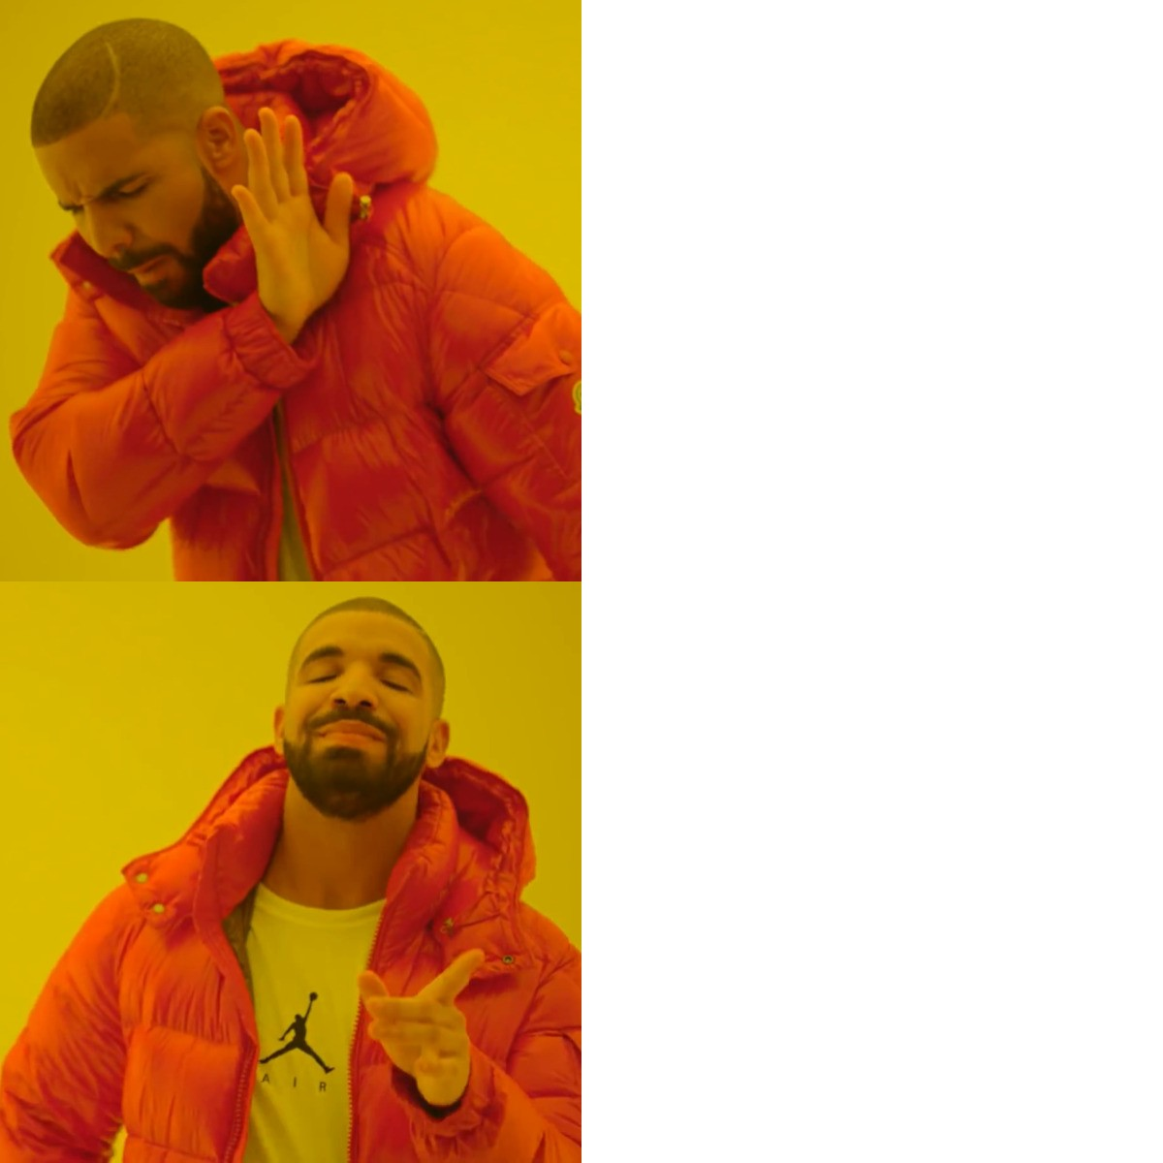
Today’s Content
STRESSING OVER
CONTENT AND EXAMPLES
Feedback from grading TAs
Common mistakes
Marking scheme tips
Final tips
Hack Your Brain
Wordle!
EXAM SUCCESS 101

Slide 4
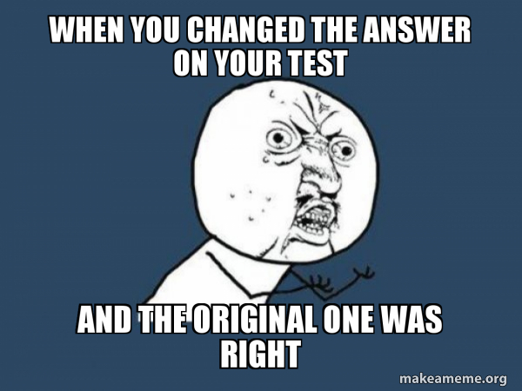
Feedback from Graders – Trust your gut!
Students ended up erasing/crossing out correct (or more correct) outputs when they revisited the question.
“Let them know to trust their guts the first time around, a lot of the time their instincts are right, and it really sucks when I can't give them marks because they doubted themselves”

Slide 5
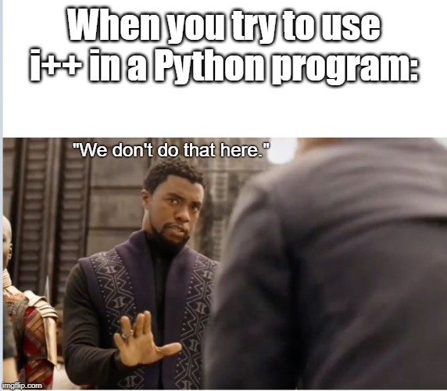
Feedback from Graders – Syntax is important
“I would say the best advice is to write your functions without syntax errors… they give bad impressions to graders”
I know for some parts it’s not easy to avoid syntax errors. However, it’s hard to give many partial points when there are MANY trivial syntax errors:
Missing colons
Using = instead of ==
Indentations
Incorrect function calls
(i.e., sleep(wait_sec) instead of time.sleep(wait_sec))

Slide 6
Feedback from Graders – Keep it simple
“I think students confused themselves by over-complicating the problem.”
For Q3 (the ‘if’ statement problem), students used several loops that were not needed
For Q5, you just needed to write the math equation inside a single while loop. Students over-complicated this in different ways, finding many complex ways to replicate the equation that was already given (ex: how to flip the negative sign for each term)

Slide 7
Feedback from Graders – Read carefully
Many students ignored the type contract within the docstring indicating the type of variable to return.
Pay attention to all docstrings and the type contract
(str) -> float
(str, bool) -> None
(ClassName) -> str
(ClassName, str) -> None
(dict of {int : list of str) -> dict of {str : list of int}

Slide 8
Marking Scheme Tips
Common trends
Correctly imports any necessary modules
Returns what the docstring says to return
Completes any necessary conversions (such as with input function)
Defines some accumulator variable (if you need to return some new data structure)
Correct conditional logic (including loops and if statements)
Comments help explain yourself, especially when you forget a method or how to use it

Slide 9
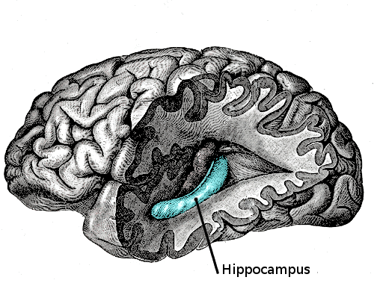
Hack Your Brain
TLDR: Be chill. Don’t stress.
Stress increases cortisol levels in your brain
Cortisol fits into your memory receptors
Impairs memory recall, while promoting memory formation
One of your many memory receptors

Slide 10

Final Tips
Put yourself in ‘Exam Mode’ when in ‘Study Mode’
Take your time and read questions carefully
Be kind to your TAs
Write legibly and clearly
Use apt comments, including arrows and labels if you need more space to keep writing
Do your best
Stay calm

Slide 11


Good Luck and Have Fun!

Slide 12
How did Josh Wardle store solutions?

